Slide 1
Project 2: Multi-Tier Architecture in AWS
Everett Enterprises
Presented by Team Trinity(TT) Soakers:
J. Tucker, J.Jay, T. Ndukong, T. Hill
CCP Tyrone Hill

Slide 2
AWS Architecture (Diagram)
A complete overview of the design
CCP Tyrone Hill

Slide 3






AWS Technical Architecture/Diagram(Slide goes here)
Group icon
AWS Cloud
Availability Zone 1
Availability Zone 2
Layered groups
Virtual Private Cloud (VPC)
Service icon
NAT gateway
Amazon EC2 Auto Scaling
NAT gateway
Auto Scaling group
Instance
Instance
Auto Scaling group
Resource icon
Instance
Instance
CCP Tyrone Hill

Slide 4
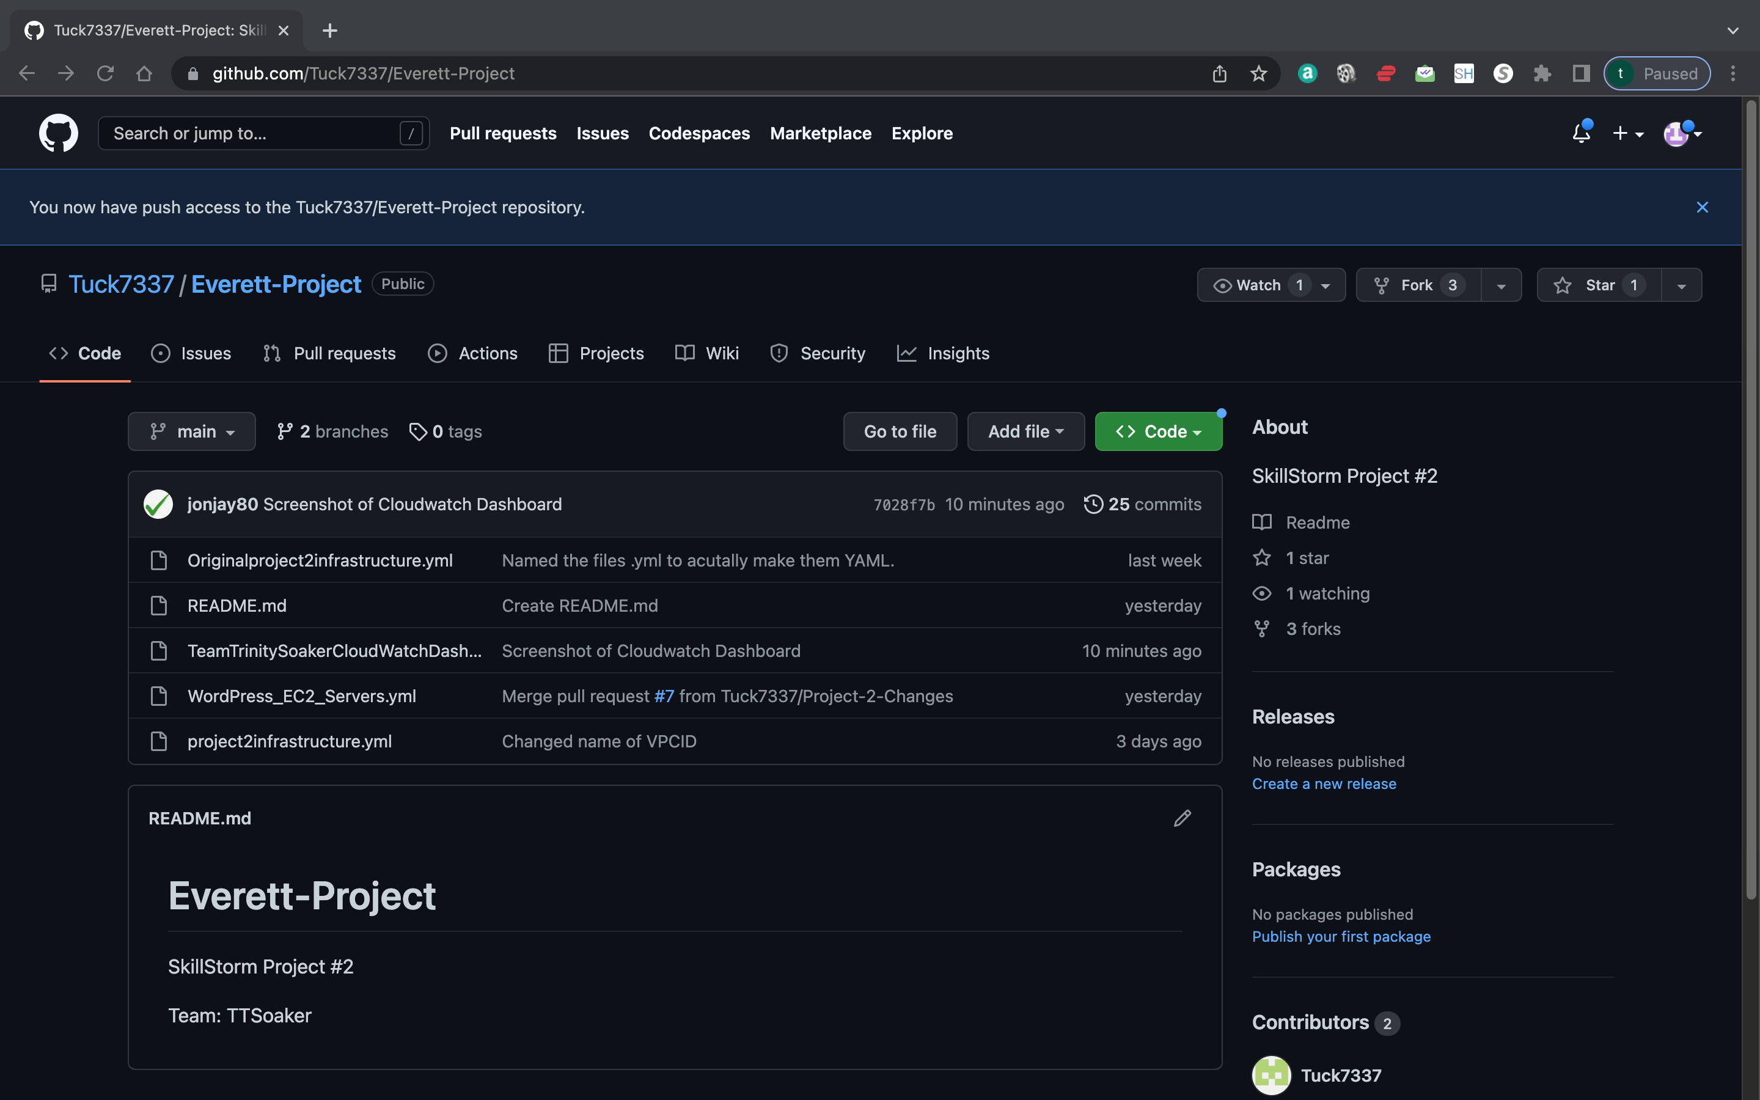


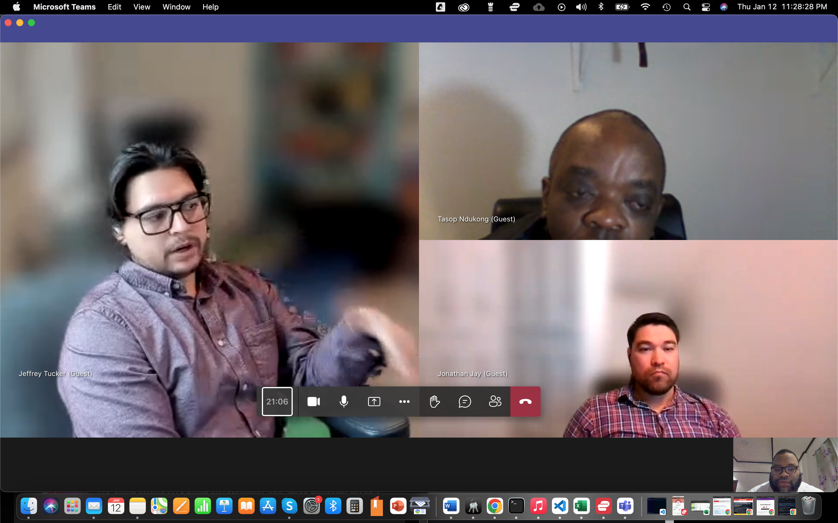

Development
CCP Jeffrey Tucker

